Slide 1
Applications of Mathematics

Slide 2
Simple Linear Regression
with Python code

Slide 3
What are good regression models?
Regression models are used for predicting a real value, for example, salary or height. If your independent variable is time, then you are forecasting future values. Otherwise, your model is predicting present but unknown values. Examples of regression techniques include:
Simple regression
Multiple regression
Polynomial regression
Support Vector Regression
Important Note: Regression analysis is not used to interpret cause-and-effect relationships between variables. Regression analysis can, however, indicate how variables are related or to what extent variables are associated with each other. In so doing, regression analysis tends to make salient relationships that warrant a knowledgeable researcher taking a closer look.

Slide 4
What is linear regression?
Simple linear regression is a statistical method you can use to study relationships between two continuous (quantitative) variables:
independent variable (x) – also referred to as predictor or explanatory variable
dependant variable (y) – also referred to as response or outcome
So how can you find the correlation between those two variables?
In case of linear regression we would be using past relationships between x and y
to find a linear equation of type
Y = B + Ax ( use this equation to make predictions.)
Ε(y) = (β0 +β1 x).
Notes:
Linear Regression is a basic and commonly used type of predictive analysis.
It’s the most widely used of all statistical techniques. It quantifies the relationship between one or more predictor variables and one outcome variable.
Regression analysis is commonly used to show the correlation between two variables.
Linear regression looks at the relationship between the data you have and the data you want to predict.
To be clear, though, we’re talking about expectations (predictions) and not absolute certainty!
(which we call our training data)
The goal of any regression model is to predict the value of y (dependant variable) based on the value of x (independent variable).
In order to figure that out, we’ll create a model that will tell us what is the best fitting line for this relationship.

Slide 5
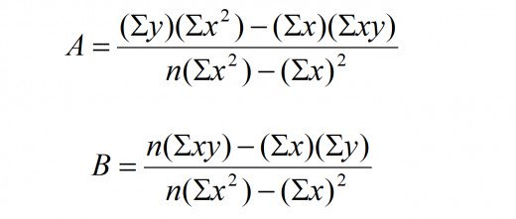
The letters ‘A’ and ‘B’ represent constants that describe the y-axis intercept and the slope of the line. To find the equation of line, we would need to use the below formula to get A and B.
Notes:
The letters ‘A’ and ‘B’ represent constants that describe the y-axis intercept and the slope of the line.
To find the equation of line, we would need to use the below formula to get A and B.
A is the intercept
B is the slope

Slide 6
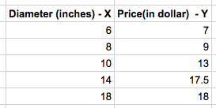
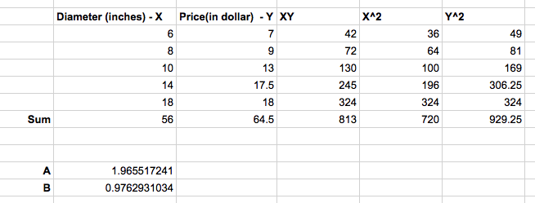
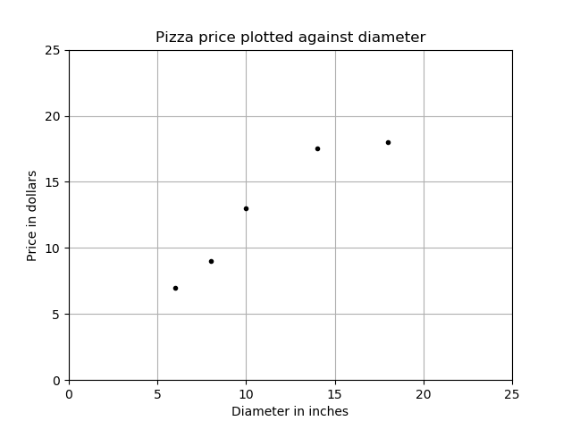
Suppose you visit a pizza restaurant whose menu looks somewhat like this:
You would like to know the approximate price of your pizza if it were 12 inches in diameter. Its not there in the menu but with a linear regression model you might be able to find it.
Notes:
The above table is called our training set, because this is what we would use to model the relationship between diameter and the price of pizza.
The training set when plotted on a graph looks like this:
Our line equation becomes Y = 1.965517241 + 0.9762931034X. So, the approximate price of pizza when the diameter is 12 inches is around $13.68 (rounded off)

Slide 7
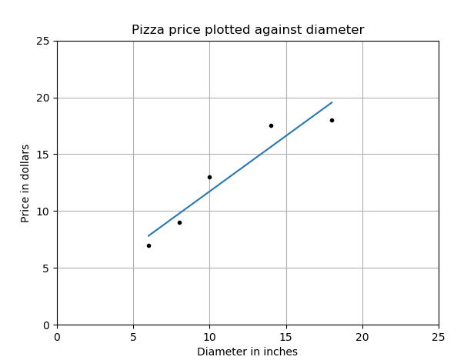
The plot of the above equation on our previous graph now looks something like this:
Our line equation becomes Y = 1.965517241 + 0.9762931034X.
So, the approximate price of pizza when the diameter is 12 inches
The blue line represents our linear regression model line and the dots the training data set.
Using training data to learn the values of the parameters for simple linear regression that produce the best fitting model is called ordinary least squares or linear least squares.
Notes:
So, the approximate price of pizza when the diameter is 12 inches is around $13.68 (rounded off)
The Least Squares Method is a statistical procedure for using sample data to find the value of the estimated regression equation.
The Least Squares Method was proposed by Carl Friedrich Gauss, who was born in the year 1777 and died in 1855.
The Least Squares Method is still widely used

Slide 8
Some examples of real world use of Linear Regression :
Number of calories burnt versus the number of miles you run.
The amount of electricity that is needed to run a house based on the size of house.
Height and weight relationship, As height increases, you’d expect weight to increase, but not perfectly.
Amount of alcohol consumed and the amount of alcohol in your bloodstream

Slide 9
Conclusion
It has also became an extensive part of all the science and technological developments made by humans and no developments in the field of science is possible without mathematics.

